Slide 1

Speech Emotion Recognition using Recurrent Neural Networks
Bledea Mihaela Alexandra

Slide 2




Introduction

Slide 3
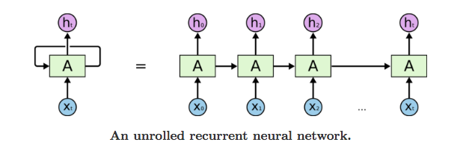
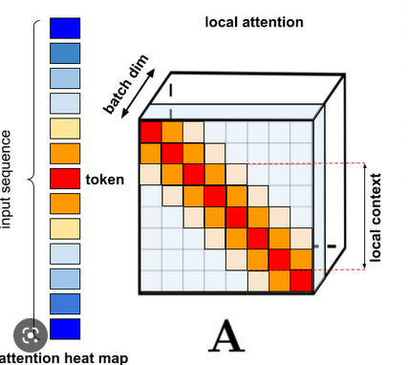
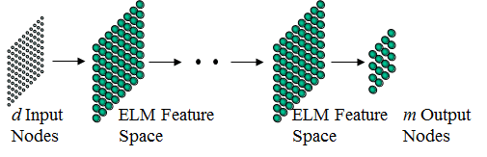
Different approaches

Slide 4
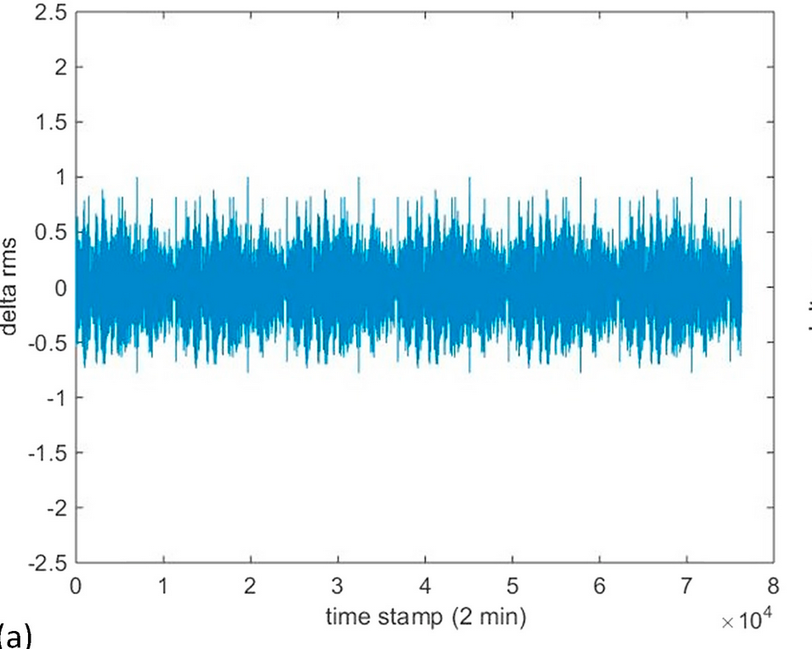
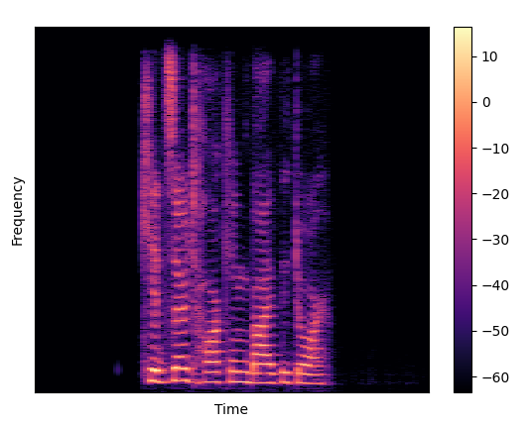
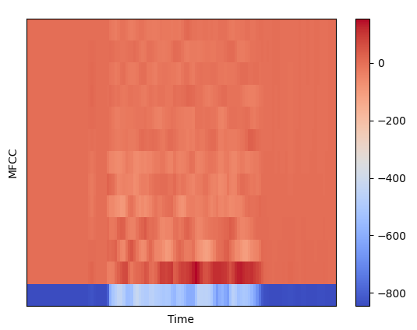
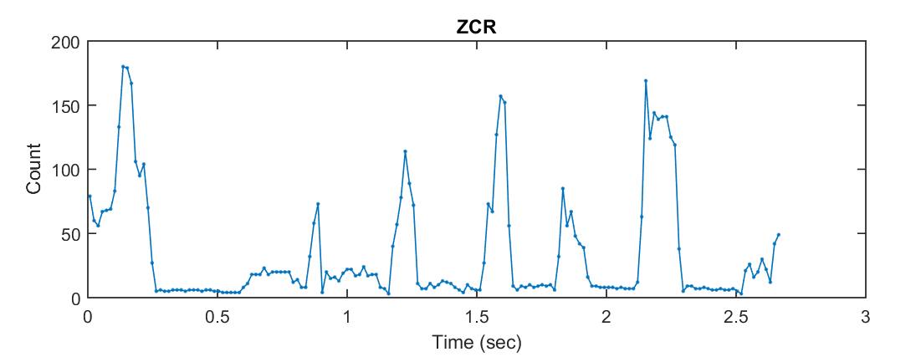
Features

Slide 5
Proposed model
RELU
SOFTMAX
INPUT
128 units
128 units
32 units
size 7
LSTM
LSTM
DENSE
OUTPUT

Slide 6
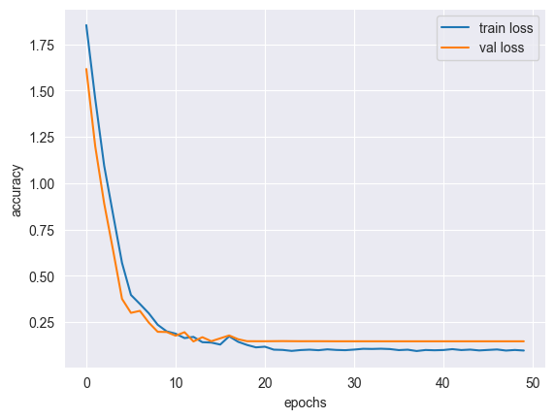
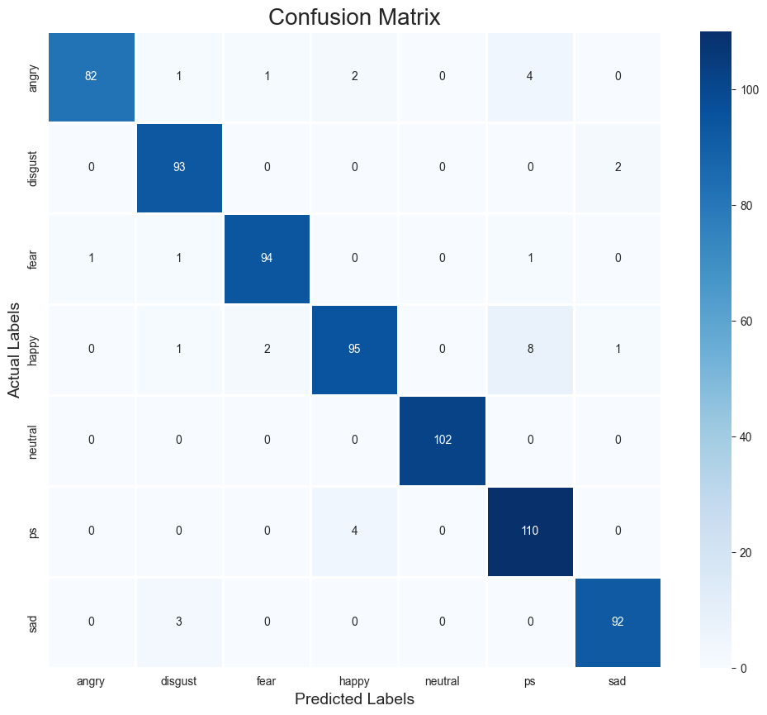
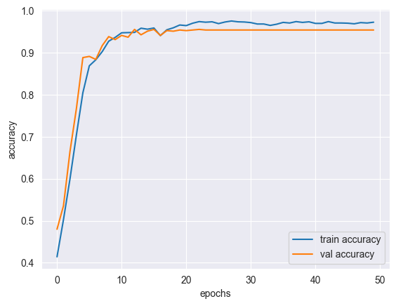
Experiments

Slide 7

Check out the GitHub code for more information

